Slide 1
NLP

Slide 2
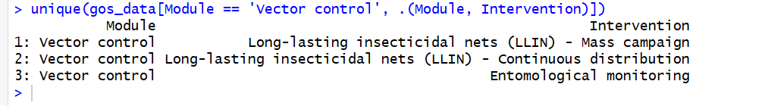
NLP
Purpose of the project was to more accurately classify line items in budgets, because it seems like errors from the country teams are common in matching activity descriptions to the modular framework.
For background, the Global Fund moved to a new grant-making structure in 2016 which included a new way of classifying financial documents, called the ‘Modular Framework’. This contains a broad category called ‘module’ and a more specific category called ‘intervention’ that help explain what money is going towards.

Slide 3
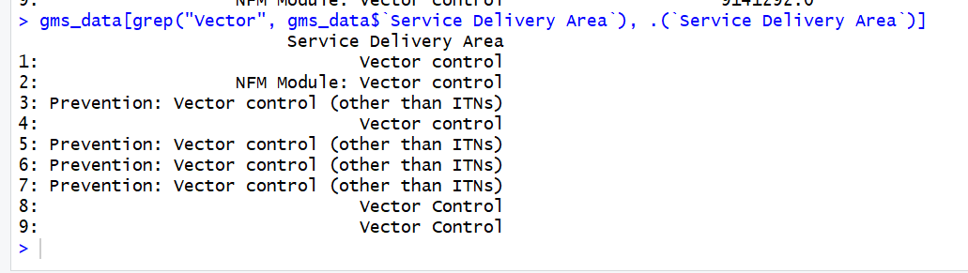
NLP
Before 2016, funds were categorized by ‘service delivery area’, which can be thought of generally as a combination of module/intervention (although this is not true in all cases, and there are a few key exceptions).

Slide 4
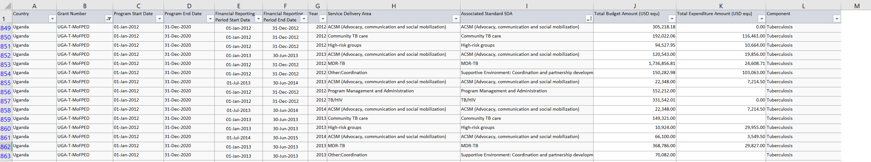
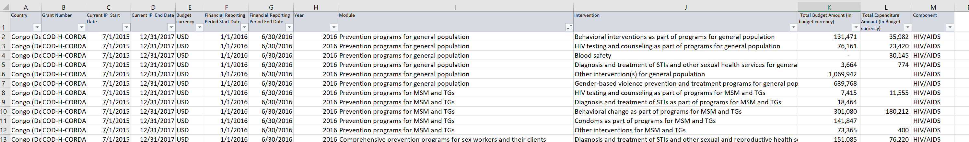
Information from GOS
Pre-2016: Service Delivery Areas
Post-2016: Modules and Interventions

Slide 5
Side note-
Pre-2016
Post-2016
This is no longer a valid module under the current modular framework

Slide 6
Information from GOS
Columns renamed to fit framework of our map
Pre-2016
Module
Intervention
Post-2016
Module
Intervention

Slide 7
Internal map for PCE
We search in raw files for columns ‘module’ and ‘intervention’, merge with this map many-to-many, and if multiple rows are matched we multiply by the coefficient to redistribute budget and expenditure numbers. This map is applied to all GF budgets, PU/DRs, and GOS data.

Slide 8
Obviously it would be great to find another way to do this, because there is a high potential for error here! Enter NLP…

Slide 9
NLP
Concept was to take a third column, ‘activity description’, and use that as a method for more accurately classifying budget line items into module/intervention.
Two-fold purpose: Get rid of the map altogether, particularly the redistribution with coefficients, AND determine if the modular framework classifications by the country teams were inaccurate.
Longer-term purpose of creating a tool that could be shared with the Global Fund to help them accurately classify budgets, and that might be used to help push for more training on the modular framework at the country-level.

Slide 10
Where does activity description come from, and what does it contain?
Current budgets – (example, UGA-H-MOFPED)
Module | Intervention | Activity Description
Treatment, care and support | Differentiated ART service delivery | Procure ARVS
Treatment, care and support | Differentiated ART service delivery | PSM costs for ARVS
Treatment, care and support | Differentiated ART service delivery | Procure Lab reagents
Treatment, care and support | Differentiated ART service delivery | PSM for Lab reagents
Treatment, care and support | Prevention, diagnosis and treatment of opportunistic infections | Procure Cotrim
Treatment, care and support | Prevention, diagnosis and treatment of opportunistic infections | PSM for Cotrim
Treatment, care and support | Treatment monitoring - Drug resistance surveillance | Develop the National HIV DR monitoring strategy.
Treatment, care and support | Treatment monitoring - Drug resistance surveillance | Conduct Drug resistance studies.
Treatment, care and support | Other intervention(s) for treatment | Conduct cervical cancer screening in 14 RRH
Treatment, care and support | Other intervention(s) for treatment | Conduct annual sentinel surveillance survey
Treatment, care and support | Differentiated ART service delivery | TA to support differentiated service delivery models rollout
Some of the older budget files we have also contain activity description. None of the GOS data, before or after 2016, contains activity description, and neither do any of the PU/DRs.

Slide 11
Examples of Activity Description
Procure Test Kits
PSM for HIV Test Kits
Procure ARVS
PSM costs for ARVS
Procure Lab reagents
PSM for Lab reagents
Procure Cotrim
PSM for Cotrim
Develop the National HIV DR monitoring strategy.
Conduct Drug resistance studies.
Conduct cervical cancer screening in 14 RRH
Conduct annual sentinel surveillance survey
Procure Condoms
PSM for Condom
Procure Lubricants
PSM for Lubricants
Procure condom dispensers
PSM cost for Condom dispensers
Conduct updates orientations for media institutions to enhance accurate and responsible reporting on HIV issues,
Scale up IEC/BCC messages using multiple and innovative channels.
Procure film Van to support BCC interventions
Conduct clinical audits and mentorship programs in MARPI Model facilities
Support ongoing mentorship of the healthcare service providers
Conduct bi-annual audits in MARPI Model Facilities for quality improvement
Essay Drama and debate competitions
Support school health conferences
Facilitate learners to address Menestral hygiene challenges
Procure Computers for MIS
Support upgrade and link the 24 hour child and GBV helplines into a national helpline handling both GBV and violence against children and women cases.
International conference participation
Procure Motor Vehicle
Support Program HR for ACP
Support One-day bi-annual oversight and monitoring meetings for CSOs targeting representation from sub-entities at Regional level - 4 regions.
Support One-day bi-annual oversight and monitoring meetings for LGs targeting representation from sub-entities in at Regional level - 4 regions
Support One-day bi-annual oversight and monitoring meetings for PHLAs SCEs targeting representation from sub-entities in all 116 districts
Support One-day bi-annual oversight and monitoring meetings for 8 other SCEs targeting representation from sub-entities (at national level)
TA to support differentiated service delivery models rollout

Slide 12
The challenge:
If we do want to train a machine learning algorithm to predict module and intervention from activity description, there is only a limited set of data we can apply it to. And because we’re prioritizing GOS data over individual budgets where we can, we basically aren’t importing any budget files before 2017 into the database that we share with PATH and CEPs.
How much work will this be for how much payoff?
If we can’t eliminate the internal map entirely, because we’ll continue to need it for GOS data, how do we make sure it’s error-free? (I’ve already made a lot of progress on writing in verification checks, but am open to more ideas)

Slide 13
Structure of the algorithm
What should the independent variables be for such a model? activity description doesn’t always convey a lot of information, but we’ve also considered adding in cost category, disease, and grant name.
Can we always assume that a single activity description will map to one module/intervention pair?
Concerns with training data – examples of unspecific activities
Procure Condoms
Essay Drama and debate competitions
International conference participation
Notes:
My concerns with the training data are that I don’t have documentation on how this was pulled, so I’m concerned that some of this was run through our old activity map before it was pulled, and ‘module’ and ‘intervention’ don’t actually mean module and intervention. This also could influence the opinion of whoever selected the correct module and intervention, because they weren’t asked to consider activity description on its own when the model will have to. I also did an analysis of the codes represented here and they only represent half of the codes in the modular framework, so this model couldn’t even predict half of the codes that exist. And then finally, some of the activity descriptions are just not descriptive.

Slide 14
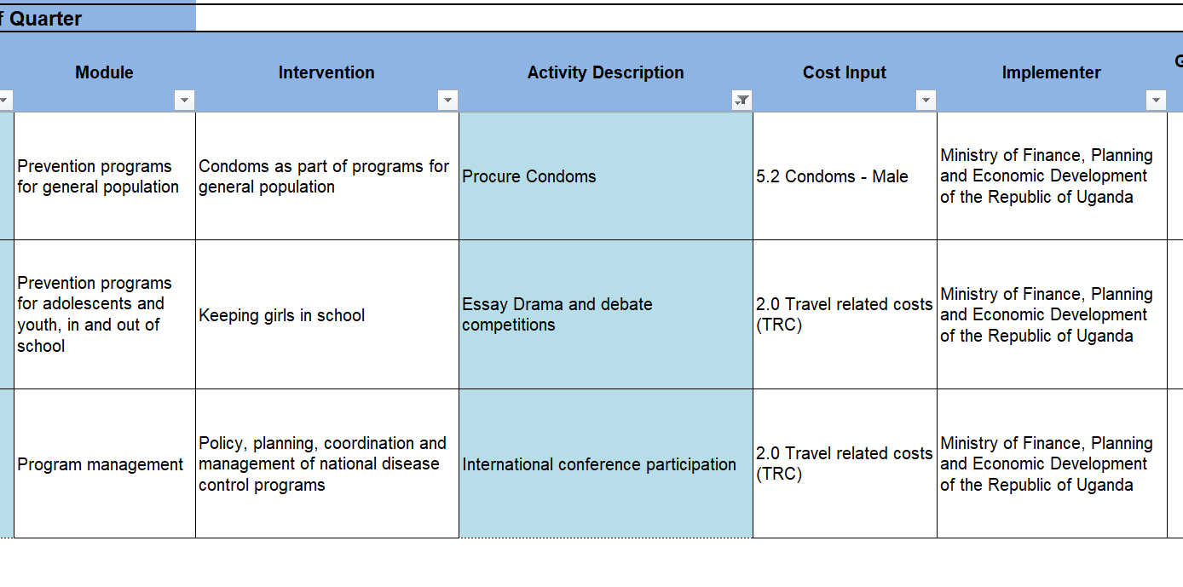
Unspecific Activities

Slide 15
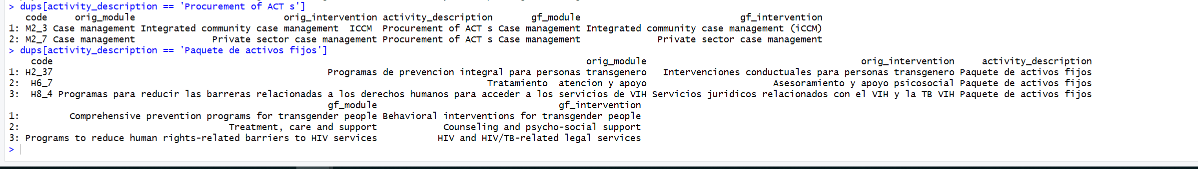
Unspecific Activities
There are also many observations (~125 unique) in our current final data where the same activity description is being mapped to different modules and interventions, or where activity description is NA even in files after the modular framework was created.

